Slide 1

Deep Dive into React Portals
Souvik Basu

Slide 2
What is React Portal

Slide 3
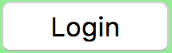
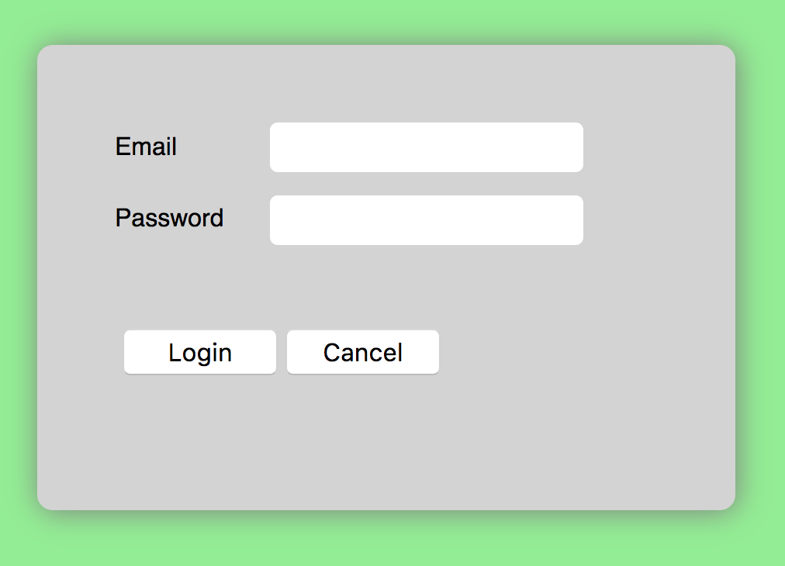
Header
showLogin

Slide 4
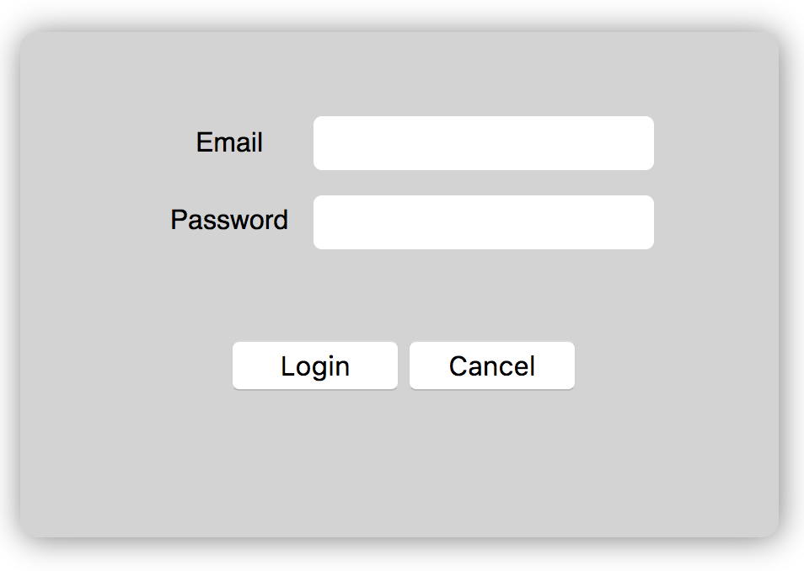
App
Header
showLogin
Main
showLogin

Slide 5
Header
showLogin
Modal

Slide 6
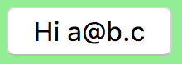
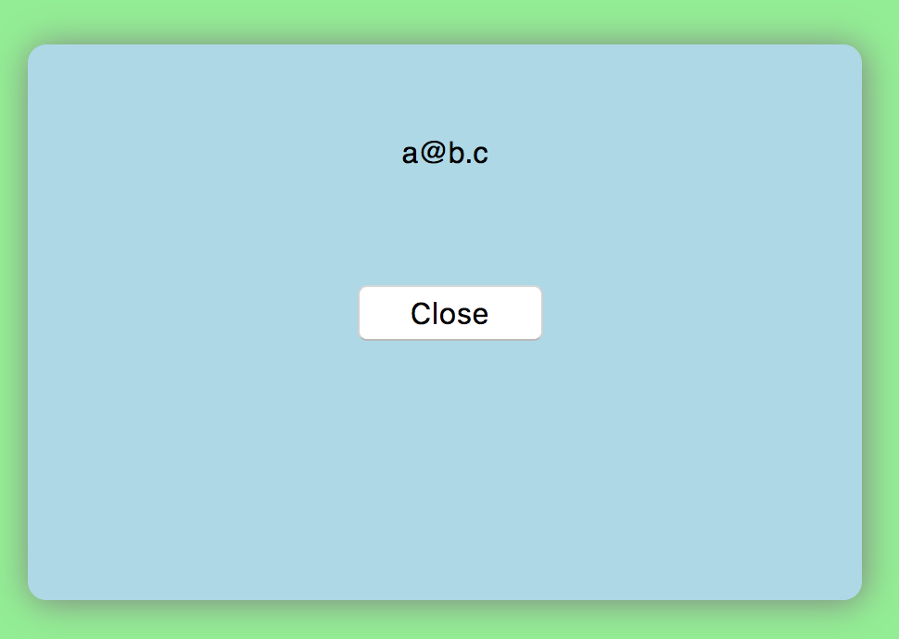
Header
email
showLogin
Modal
a@b.c

Slide 7
When to use Portals?
Always on Top
Child bigger than Parent

Slide 8
Lightbox

Slide 9
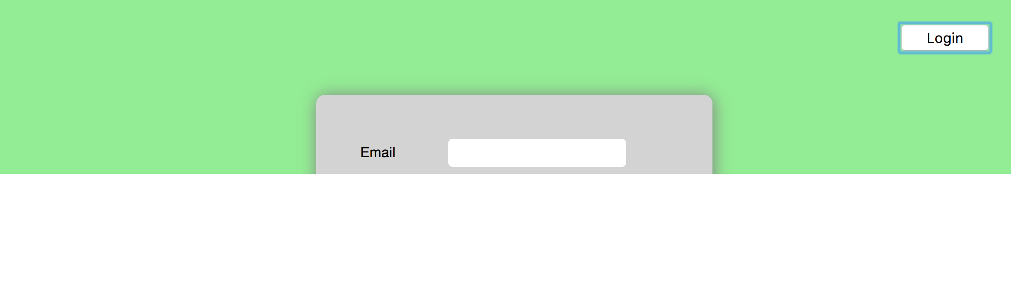
Children that spill out of parent div

Slide 10
Why to use Portals?
Handles code complexity (easier state management)

Slide 11
Concerns around usage of React Portal
Spaghetti code
Portals are like goto statement

Slide 12
goto

Slide 13

Portal inside Portal inside Portal

Slide 14
Clean design using Portals
Virtual DOM abstraction
Portal enforces to think in terms of React Elements and not DOM

Slide 15
<div>
Component 1
Component 1
<div>
Component 2
<div>
Comp 3
<div>
Comp 4
DOM
JSX

Slide 16
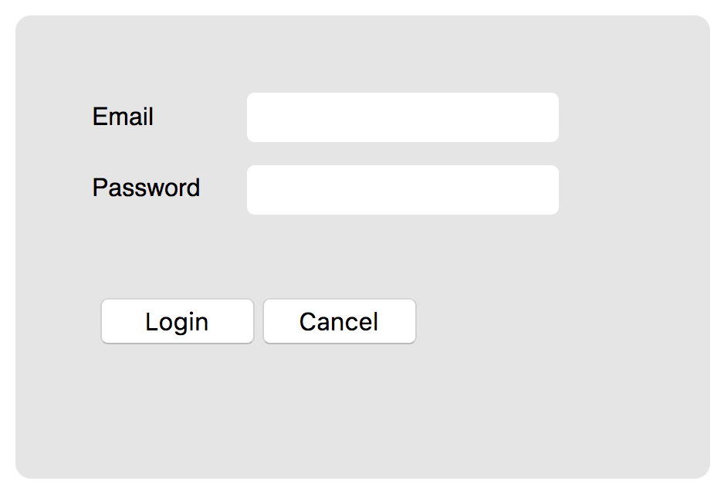
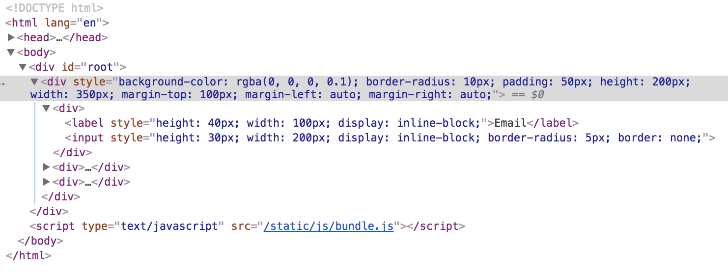
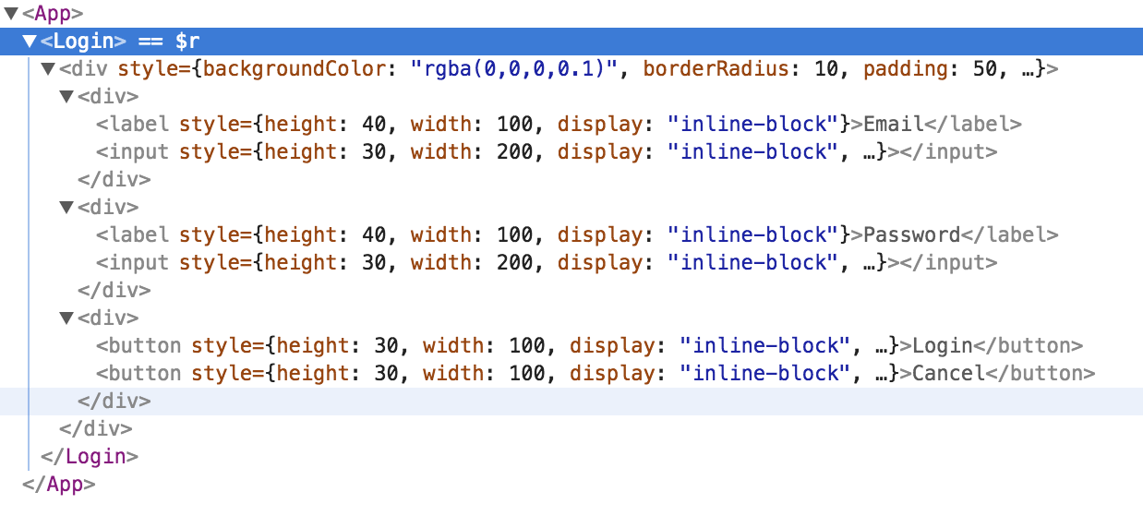

Slide 17
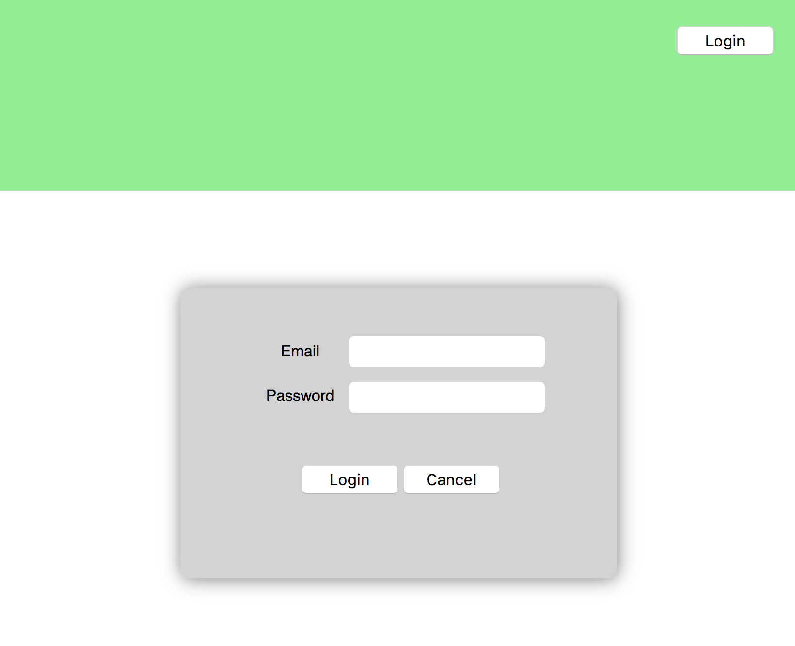

Slide 18
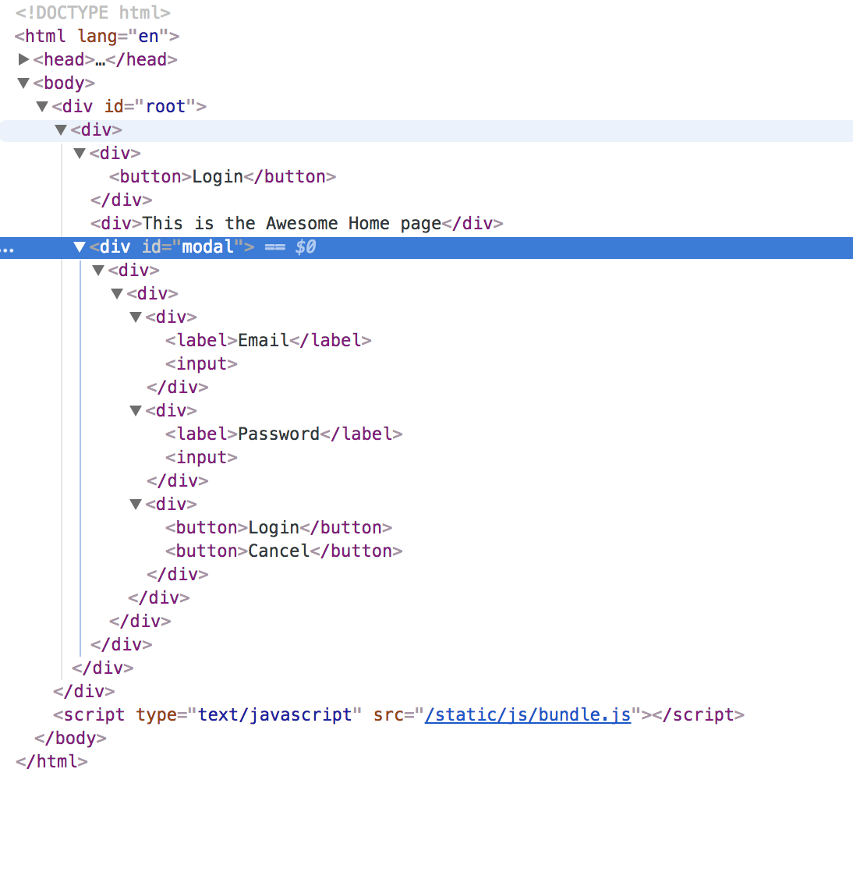

Slide 19
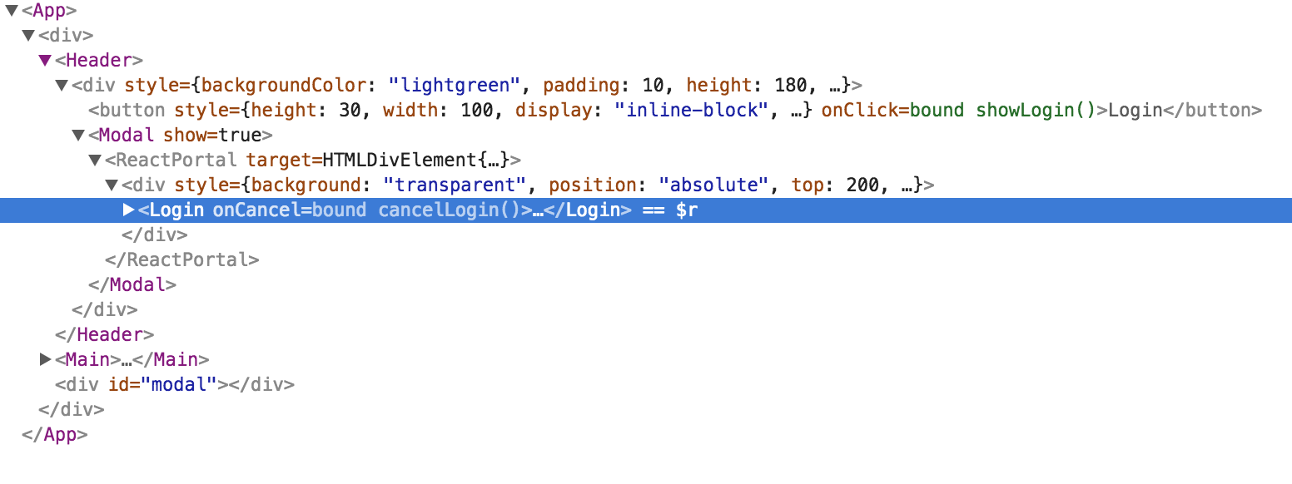

Slide 20
DOM
JSX

Slide 21
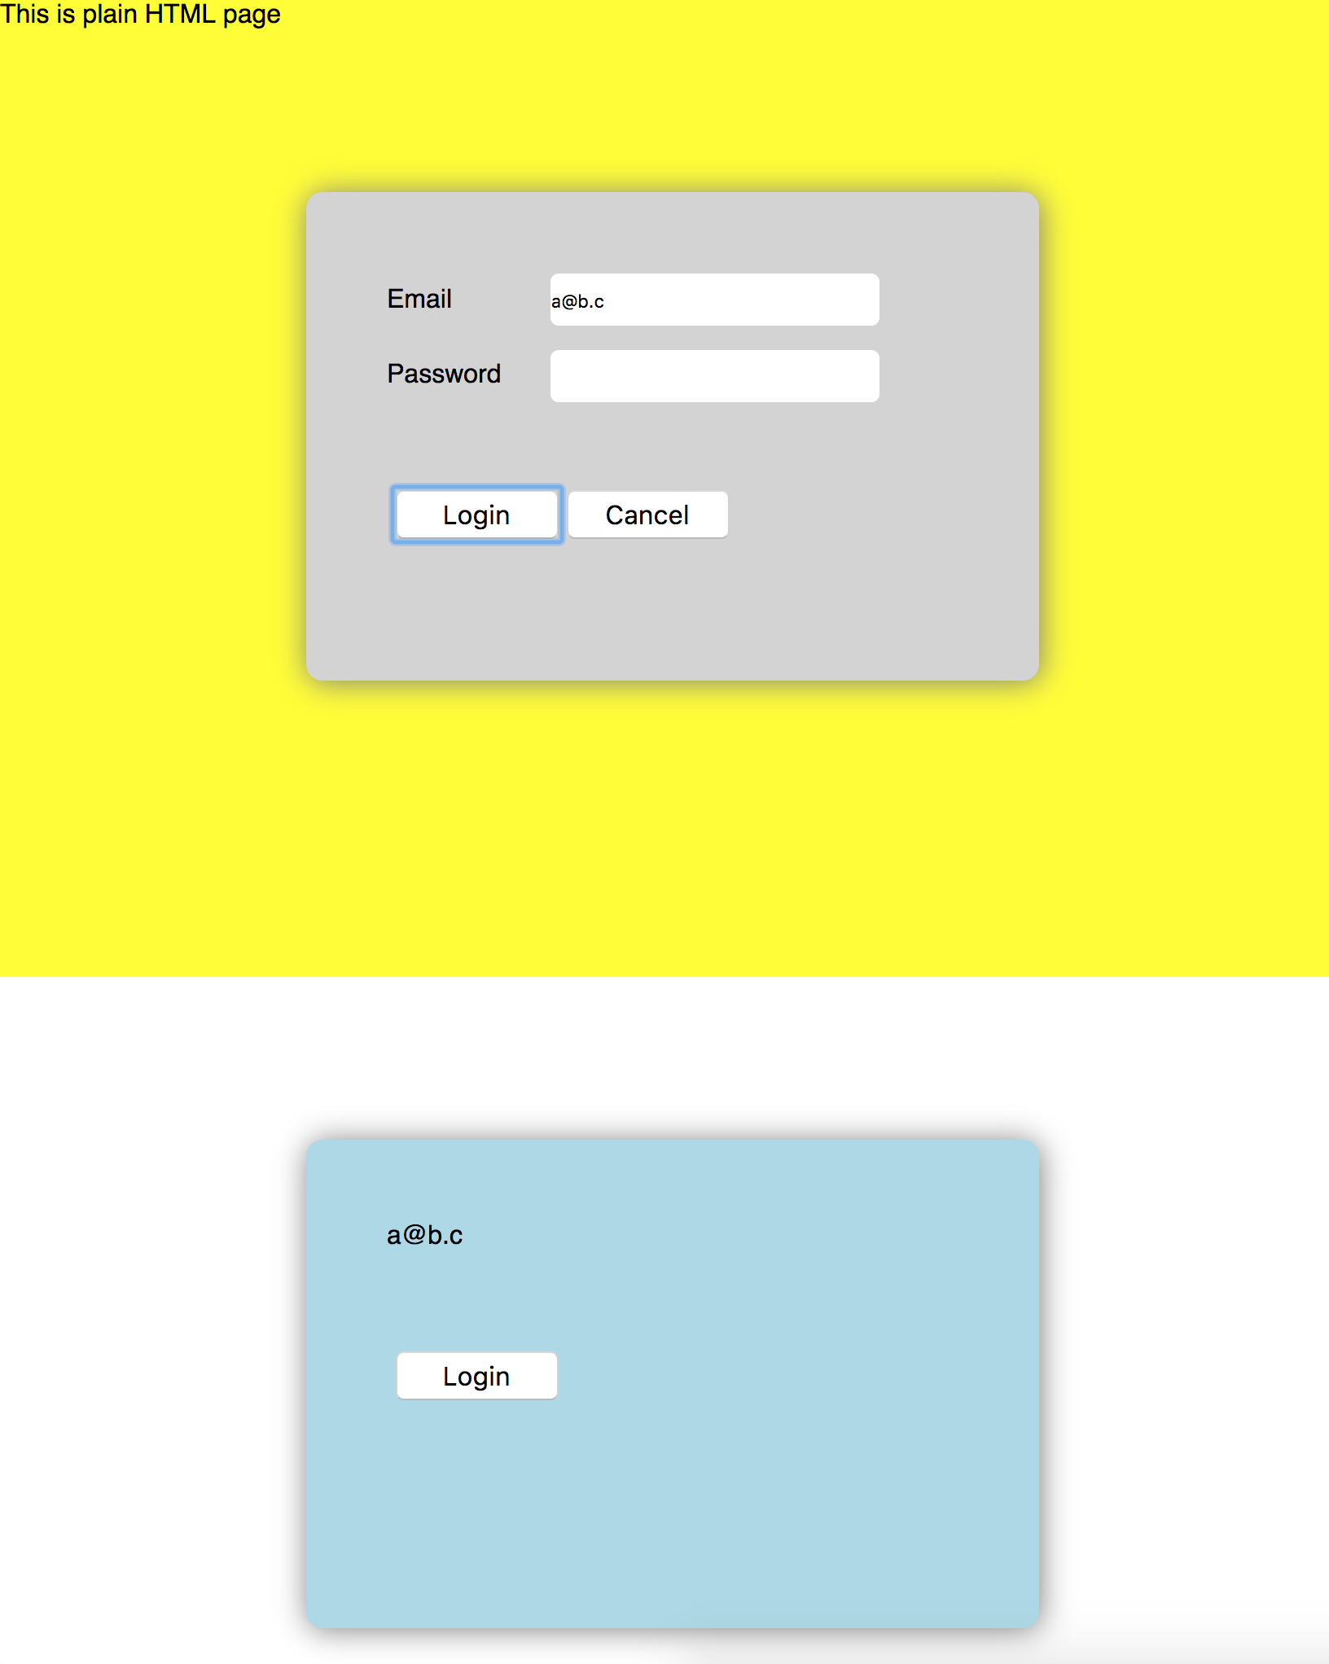

Slide 22
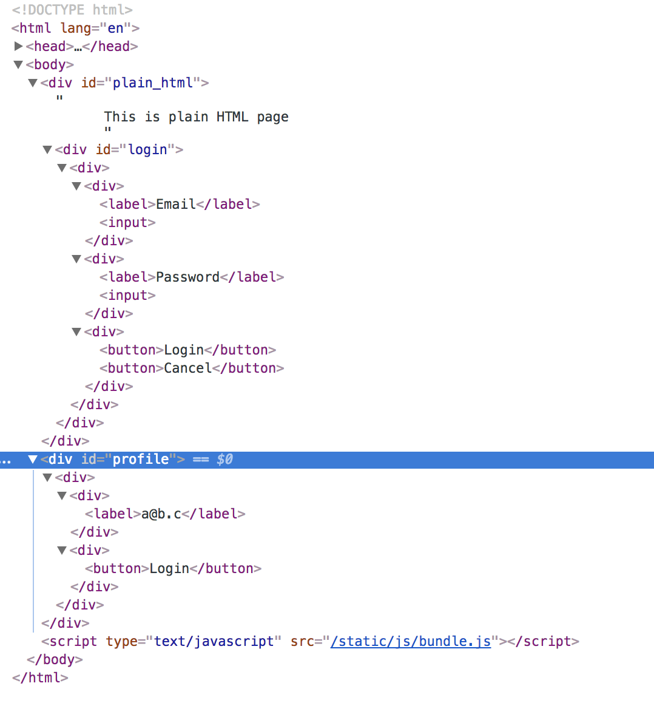

Slide 23
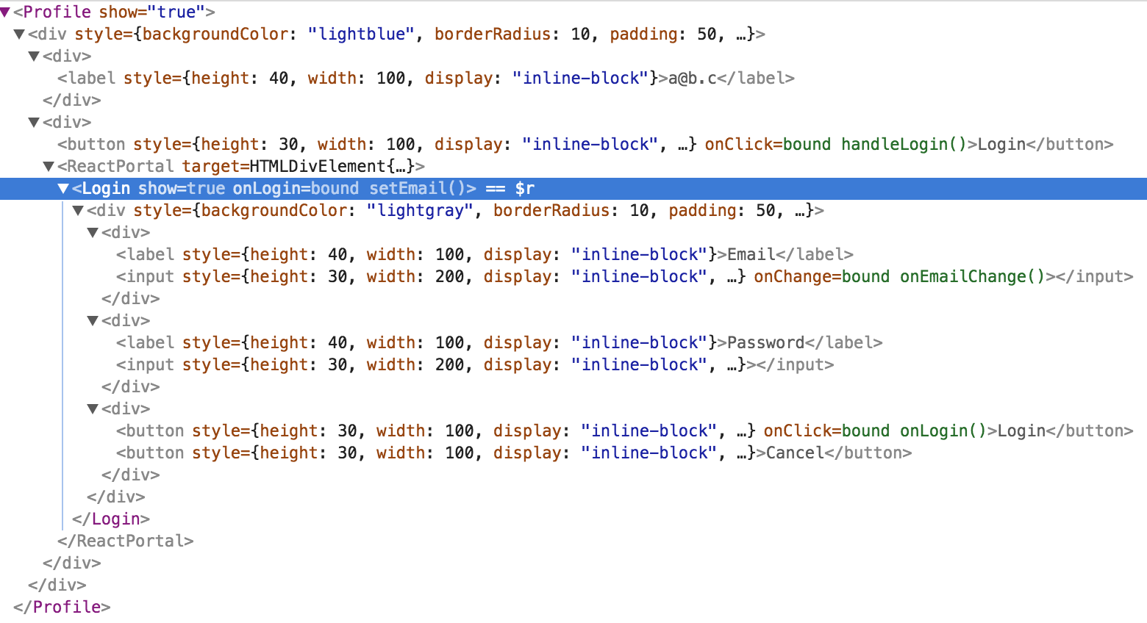

Slide 24
DOM
JSX

Slide 25
DOM
JSX

Slide 26
Testing React Portals

Slide 27
Testing using Enzyme
mount -> DOM
shallow -> Component

Slide 28
State Management in Portals

Slide 29
Gotchas with Portals
Avoid State flow as per UI designs
Rather think in terms of Components
Portals is part of ReactDOM and not React

Slide 30
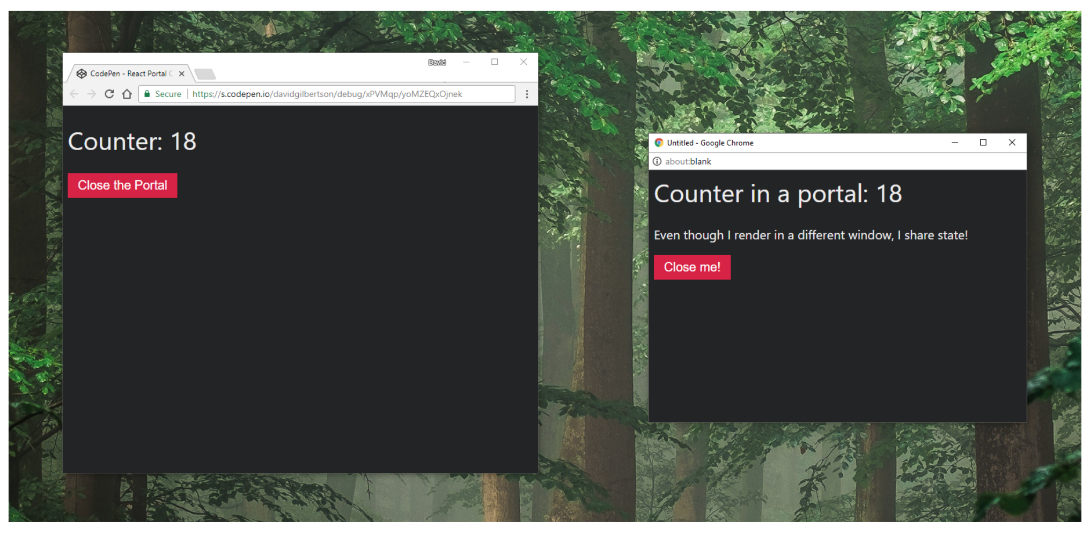
Some cool stuff
https://hackernoon.com/using-a-react-16-portal-to-do-something-cool-2a2d627b0202

Slide 31
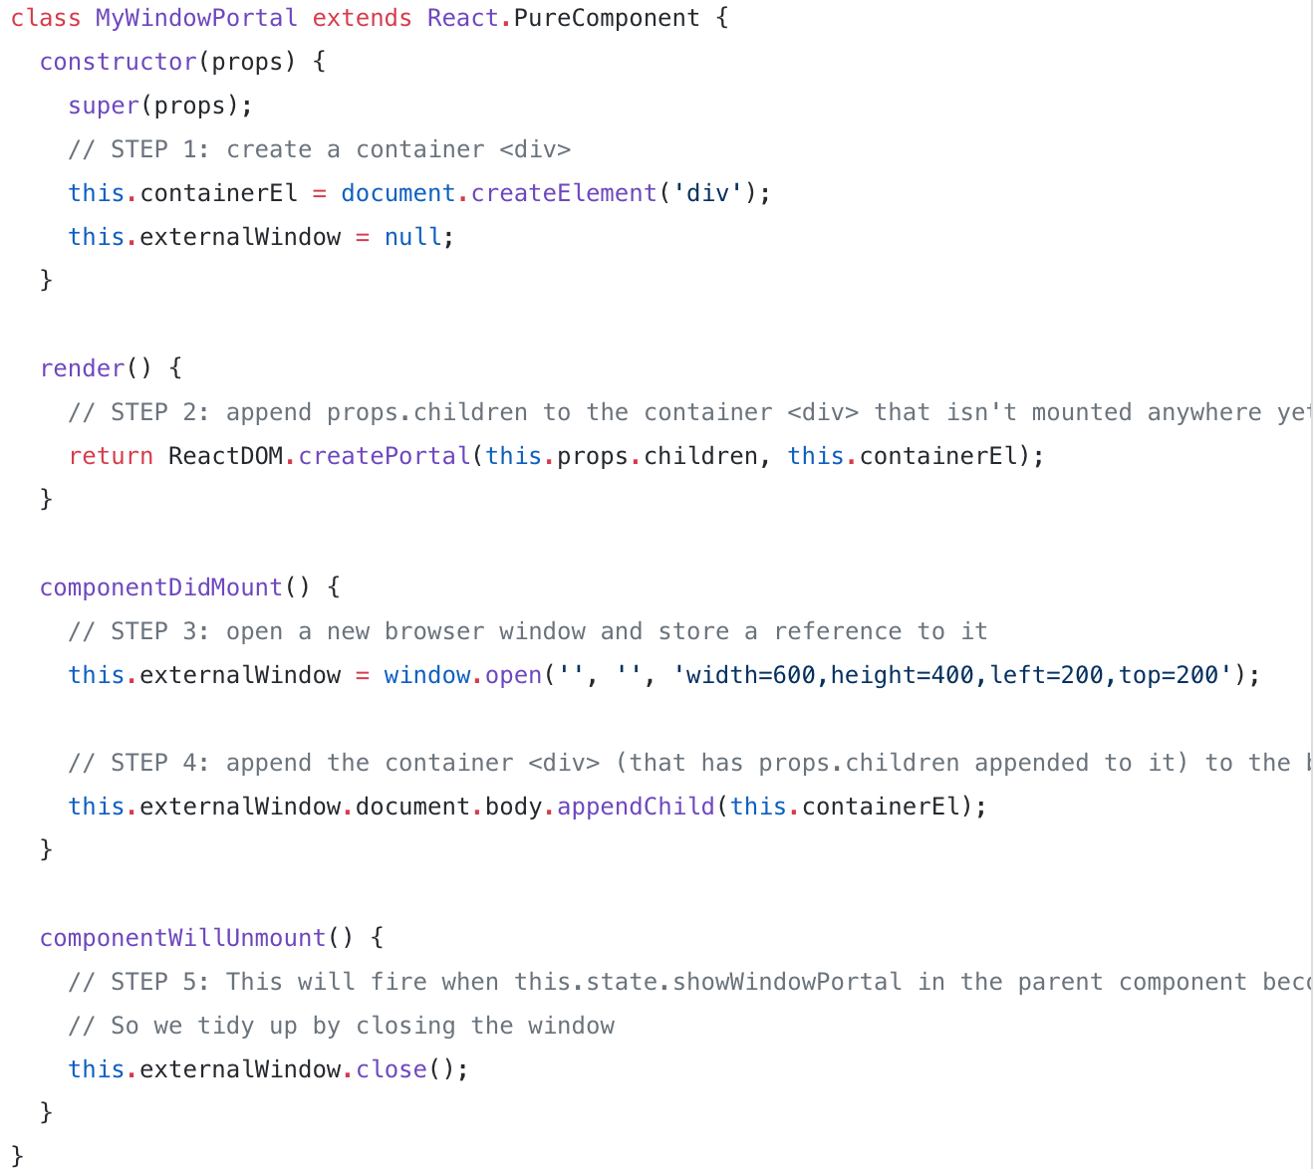

Slide 32
Q n A
Thank you
@souvikbasu
Code: bit.ly/reactportals

